Slide 1
Section 13
Decision Trees and Random Forest

Slide 2
What is a Decision Tree?
A Decision Tree is one of the Supervised Machine Learning Algorithm
Decision tree is a tree like structure in which each internal node represents a test on a attribute and each branch represents the possible outcome of the test.
We can use decision trees for both classification and regression problems.
But they are widely used for classification problems.

Slide 3
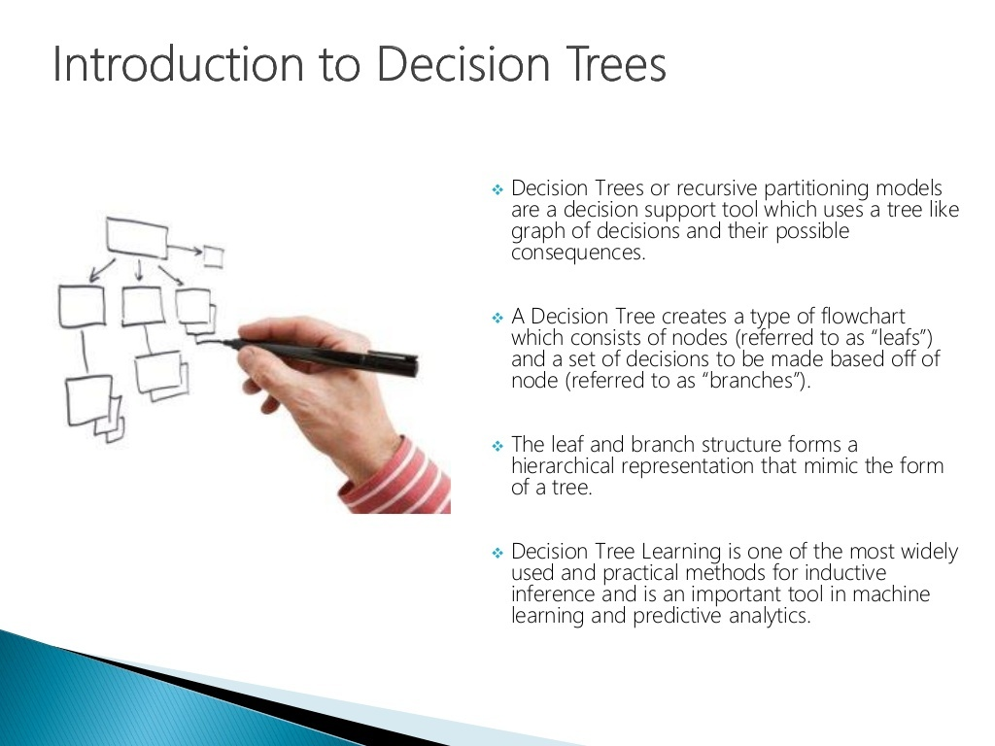

Slide 4
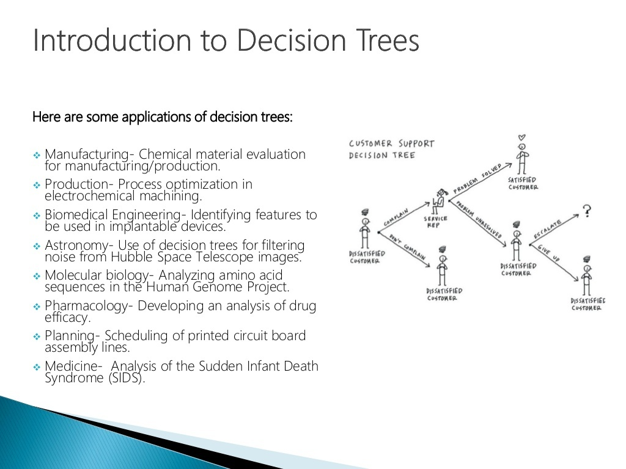

Slide 5
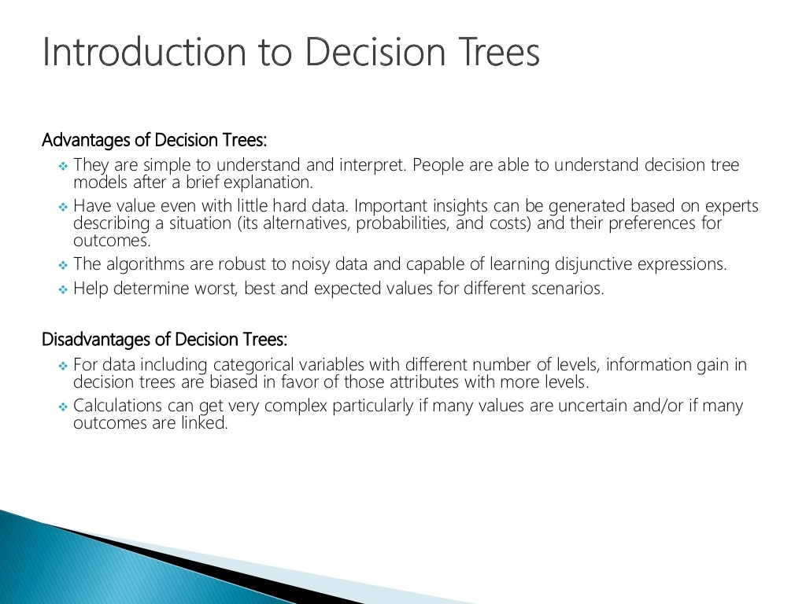

Slide 6
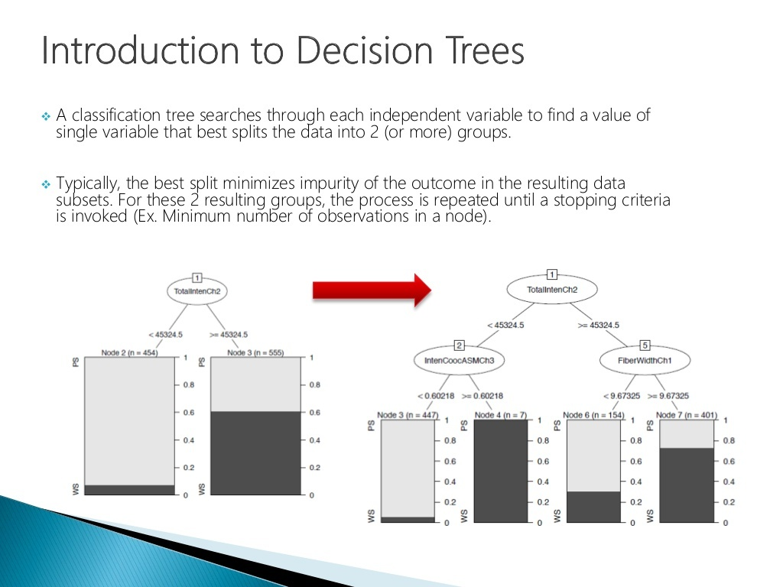

Slide 7
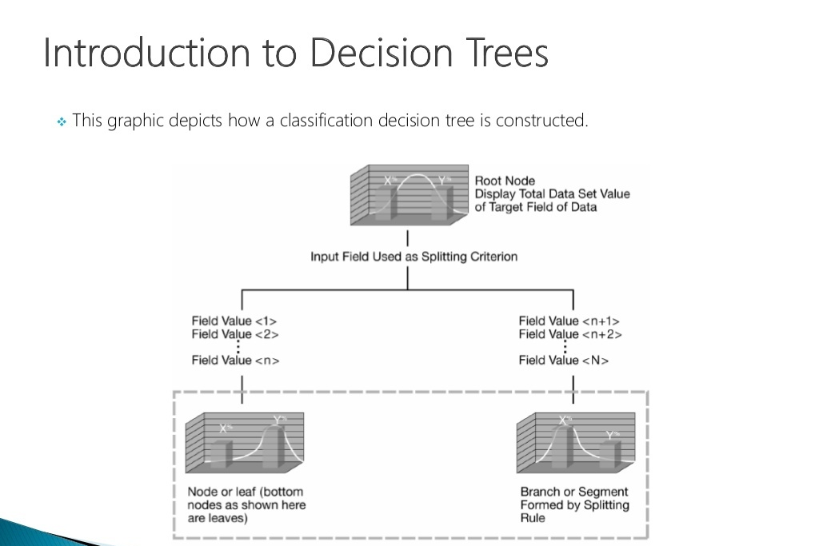

Slide 8
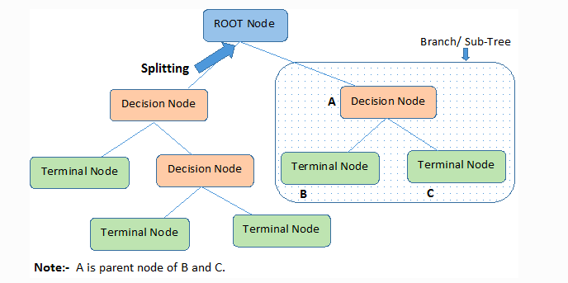

Slide 9
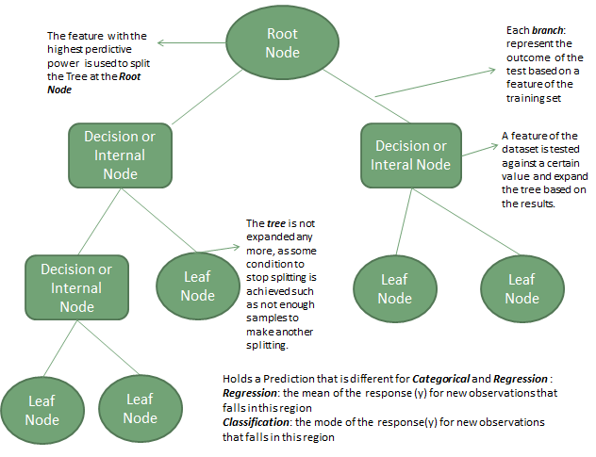

Slide 11
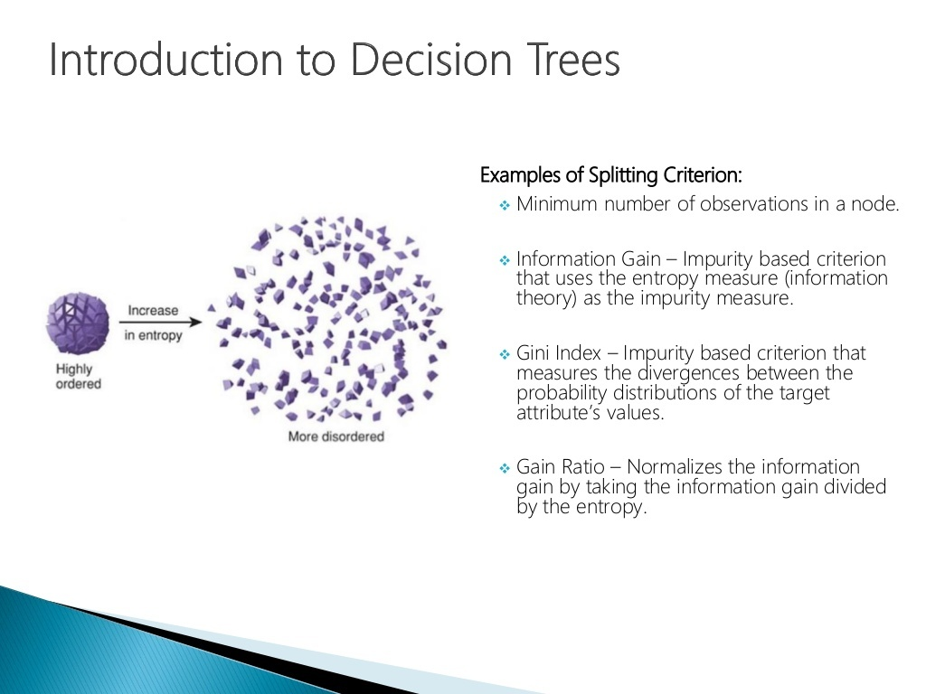

Slide 12
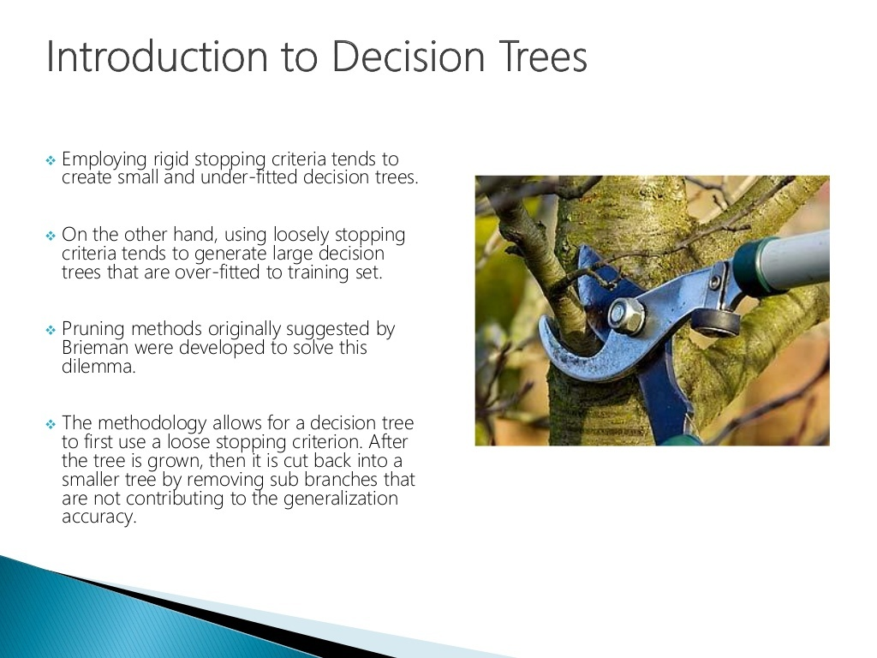

Slide 13
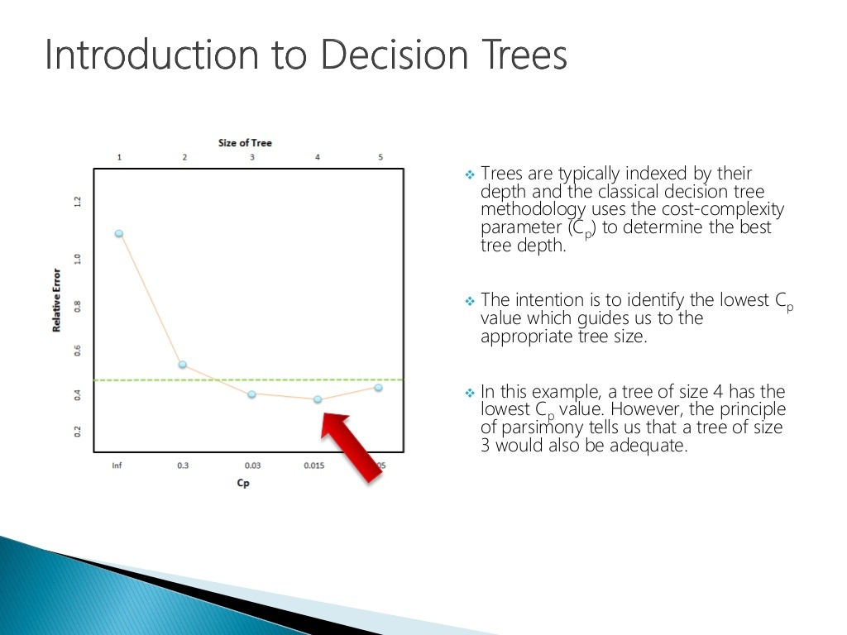

Slide 14
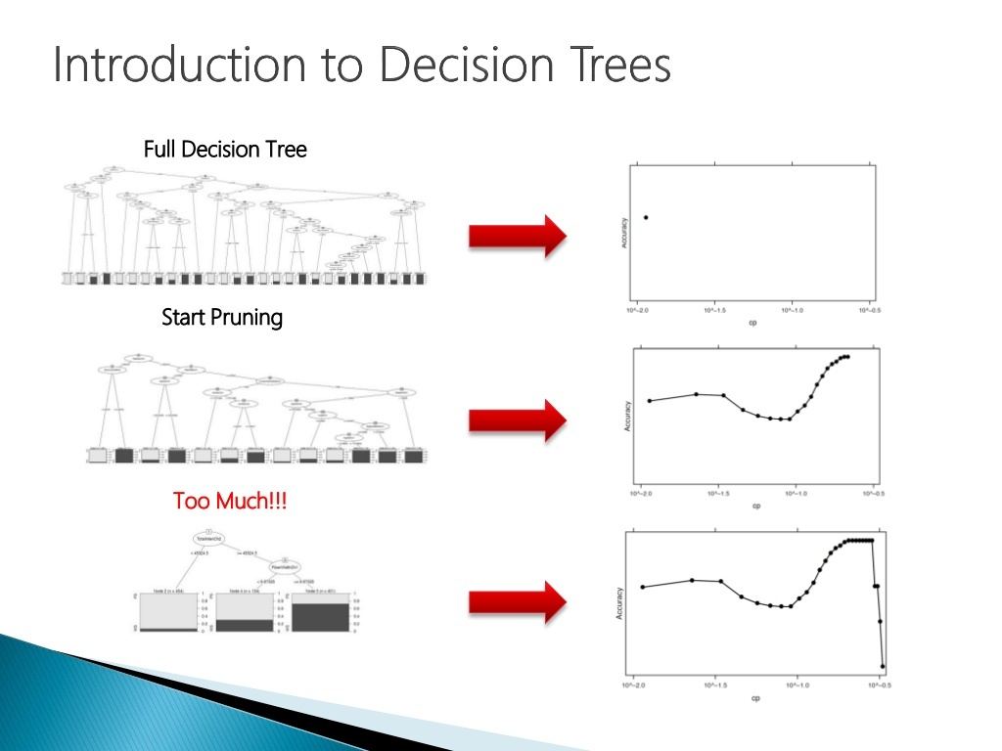

Slide 15
Properties of Decision Tree
Top most node in the tree is called root node.
Each internal node denotes a test on a attribute, it is called as decision node.
Each branch represents an outcome of a test.
And each leaf node or terminal node holds a class label.

Slide 16
Root node
Decision node
Decision node
Leaf node
Decision node
Decision node
Leaf node
Leaf node
Leaf node
Simple Representation of Decision Tree

Slide 17
Simple Example of Decision Tree:
Fever (degree celsius ) | Need to see a Doctor
36 | No
40 | Yes
41 | Yes
38 | No
39 | Yes
Fever > 38
True
False
Yes
No
This is an example of regression decision tree as the dependent variable i.e fever is continuous

Slide 18
Advantages of Decision Tree
Simple to Understand, Interpret and Visualize.
Variable Screening and Feature Selection.
Requires less effort for data preparation during pre-processing.
Missing values in dataset does not affect the process of building decision trees.

Slide 19
Disadvantages of Decision Trees
A small change in data can cause large changes in structure of decision tree.
Decision Trees often require higher time to train.
For a decision tree sometimes calculation can go far more complex than other algorithms.

Slide 20
Types of Decision Trees
Categorical Variable Decision Tree
A categorical variable decision tree includes categorical target variables that are divided into categories. For example, the categories can be yes or no.

Slide 21
2. Continuous variable decision tree
A continuous variable decision tree is a decision tree with a continuous target variable. For example income of an individual can be predicted based on available information such as their occupation, age and other continuous variable.

Slide 22
Constructing a Decision Tree
Now lets see how to construct a decision tree from raw data.
In this example we have to construct a decision tree which uses chest pain, good blood circulation and blocked arteries as attributes to predict whether a person is having heart disease or not. We have a total 303 persons data as given below
Chest Pain | Good Blood Circulation | Blocked Arteries | Heart Disease
No | No | No | No
Yes | Yes | Yes | Yes
Yes | Yes | No | No
Yes | No | ??? | Yes
...etc | ...etc | ...etc | ...etc

Slide 23
First things First….
Deciding which attribute from the data to be used at root node.
For this we start by checking how well each attribute predicts the target value.
In our case, how well Chest Pain, Good Blood Circulation and Blocked Arteries Status alone can predict that a person is having Heart Disease or not.

Slide 24
Here we are calculating how well chest pain alone predicts heart disease.
For this we will count how many persons are having heart disease if they are having chest pain, how many persons are having heart disease if they don’t have chest pain. Also we will calculate number of persons who don’t have heart disease if they are having chest pain, number of persons who don’t have heart disease if they are not having chest pain.
Chest Pain | Heart Disease
No | No
Yes | Yes
Yes | No
Yes | Yes
..etc | ..etc
Chest Pain
Yes
No
Heart Disease
Yes No
105 39
Heart Disease
Yes No
34 125

Slide 25
Similarly for Good Blood Circulation
Good Blood Circulation | Heart Disease
No | No
Yes | Yes
Yes | No
No | Yes
..etc | ..etc
Good Blood Circulation
Yes
No
Heart Disease
Yes No
37 127
Heart Disease
Yes No
100 33

Slide 26
Similarly for Blocked Arteries Status
Blocked Arteries | Heart Disease
No | No
Yes | Yes
No | No
??? | Yes
..etc | ..etc
Blocked Arteries
Yes
No
Heart Disease
Yes No
92 31
Heart Disease
Yes No
45 129
Note:- Here we are having missing value in row no. 4, There are ways to handle missing values but for now we will skip it. Also the total number of heart disease patients are different for every attribute because some patients have some missing values.

Slide 27
From observation it is clear that none of node is able to classify 100% Yes Heart Patient or 100% No Heart Patient.
So all these nodes are considered as impure.
Now, to determine which node is best as root node in our decision tree, we need to find a way to calculate and compare the amount of impurity in each node.
One of the popular way to calculate the impurity is Gini Impurity method.
Blocked Arteries
Yes
No
Heart Disease
Yes No
92 31
Heart Disease
Yes No
45 129
Chest Pain
Good Blood Circulation
Yes
No
Yes
No
Heart Disease
Yes No
105 39
Heart Disease
Yes No
34 125
Heart Disease
Yes No
37 127
Heart Disease
Yes No
100 33

Slide 28
Gini Impurity
Gini impurity measures the degree or probability of a particular variable being wrongly classified when it is randomly chosen. But what is actually meant by ‘impurity’? If all the elements belong to a single class, then it can be called pure. The degree of Gini index varies between 0 and 1, where 0 denotes that all elements belong to a certain class or if there exists only one class, and 1 denotes that the elements are randomly distributed across various classes. A Gini Index of 0.5 denotes equally distributed elements into some classes.
Formula:
Gini Impurity= 1 - ∑^{n}_{i=1} (p_{i})²

Slide 29
Calculating Gini Impurity
Let us calculate the gini impurity for chest pain
Chest Pain
Yes
No
Heart Disease
Yes No
105 39
Heart Disease
Yes No
34 125
Here Gini Impurity is given by
= 1- (probability of yes)² -(probability of no)²

Slide 30
Therefore,
Gini Impurity(right node)
= 1 - [( 34 ) / (34 + 125)]² - [( 125 ) / (34 + 125)]²
= 0.336
Similarly for left node we get,
Gini Impurity(left node) = 0.395

Slide 31
Total Gini Impurity of Chest Pain:
Now for total Gini Impurity of Chest Pain is given by the weighted average of leaf node impurities.
It is given by:
[(Total Number of persons in left node)/ (total number of persons in both node )]*(Gini Impurity of left node) +
[(Total Number of persons in right node)/ (total number of persons in both node)]*(Gini Impurity of right node)

Slide 32
Therefore it gives,
Total Gini Impurity of Chest Pain=
[ ( 144 ) / ( 144 + 159 ) ] * [ 0.395 ] +
[ ( 159 ) / ( 144 + 159 ) ] * [ 0.336 ]
= 0.1877 + 0.1763
= 0.364
Therefore, total gini impurity for chest pain =0.364

Slide 33
Total Gini Impurity of Chest Pain = 0.364
Total Gini Impurity of Good Blood Circulation
= 0.360
Total Gini Impurity of Blocked Arteries = 0.381
Blocked Arteries
Yes
No
Heart Disease
Yes No
92 31
Heart Disease
Yes No
45 129
Good Blood Circulation
Yes
No
Heart Disease
Yes No
37 127
Heart Disease
Yes No
100 33
Chest Pain
Yes
No
Heart Disease
Yes No
105 39
Heart Disease
Yes No
34 125

Slide 34
Here, we can observe that Good Blood Circulation has less Gini Impurity. So we will use Good Blood Circulation as the Root node of our Decision Tree.
Good Blood Circulation
Yes
No
Heart Disease
Yes No
37 127
Heart Disease
Yes No
100 33
Now from our dataset of 303 persons 164 person with and without heart disease are now in left node and 133 persons with and without heart disease are in right node i.e we ended up getting two impure leaf nodes.

Slide 35
Deciding next nodes
Now we have Good Blood Circulation at root node, So for attribute to be used at left side of the tree we will follow the same steps that we have used for deciding the attribute at root node.
Therefore we have to calculate Gini Impurity of Chest pain for the total persons at left node and Gini Impurity of Blocked Arteries for total persons at left node.
Similarly for right node.

Slide 36
Let’s consider left node, Total persons at left node = 164
Chest Pain
Total Gini Impurity of chest pain=0.3
Total Gini Impurity of blocked arteries=0.290
As blocked arteries have less gini impurity, so we will use blocked arteries at this node.
Yes
No
Heart Disease
Yes No
13 98
Heart Disease
Yes No
24 29
Blocked Arteries
Yes
No
Heart Disease
Yes No
24 25
Heart Disease
Yes No
13 102

Slide 37
We will follow exact same steps and we get
Good Blood Circulation
Blocked Arteries
Chest Pain
13 / 102
17 / 3
7 / 22
Note: If after calculating gini impurity, if it is greater than previous gini impurity we will make previous node as leaf node.

Slide 38
Similarly after following exact same steps for Right Subtree we get,
Good Blood Circulation
Blocked Arteries
Chest Pain
Chest Pain
13 / 102
92 / 3
Blocked Arteries
17 / 3
7 / 22
8 / 0
0 / 30

Slide 39
General Steps to construct a Decision Tree
Calculate all Gini Impurity Score.
If the node itself has the lowest score, than there is no point in separating the patients anymore and it becomes a leaf node.
If separating the data results in an improvement, than pick the separation with the lowest impurity score.

Slide 40

Entropy and Information Gain:
Entropy quantifies the degree of disorder in data. Entropy is always positive number between 0 and 1.
Another interpretation of Entropy is in terms of information content.
A completely homogeneous data has no information content in it whereas a dataset with a lot of disorder has a lot of latent information waiting to be learnt. Assume the dataset consists of only categorical attributes, both the explanatory variables and the class variable.
In terms of probabilities of finding data points belonging to various classes, entropy for a dataset D is defined as

Slide 41
Information Gain is used to determine which feature/attribute gives us the maximum information about a class.
It is based on the concept of entropy, which is the degree of uncertainty, impurity or disorder. It aims to reduce the level of entropy starting from the root node to the leave nodes.

Slide 42
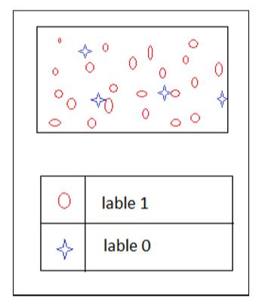
Homogeneity:
What Decision tree construction algorithm will try to do is to create a split in such a way that the homogeneity of different pieces must be as high as possible.

Slide 43
If the previous slide fig denotes a branch after a split and H be its homogeneity.
The decision tree checks whether H > some threshold then there is no further split. If the H < threshold then there will be further split.
This process will be continued where the label is sufficiently homogeneous then a leaf is created.
So we go step by step, picking an attribute and splitting the data such that the homogeneity increases after every split.
We stop splitting when the resulting leaves are sufficiently homogeneous.
There are various ways to quantify homogeneity, such as the Gini Index, Information gain, Entropy etc.

Slide 44
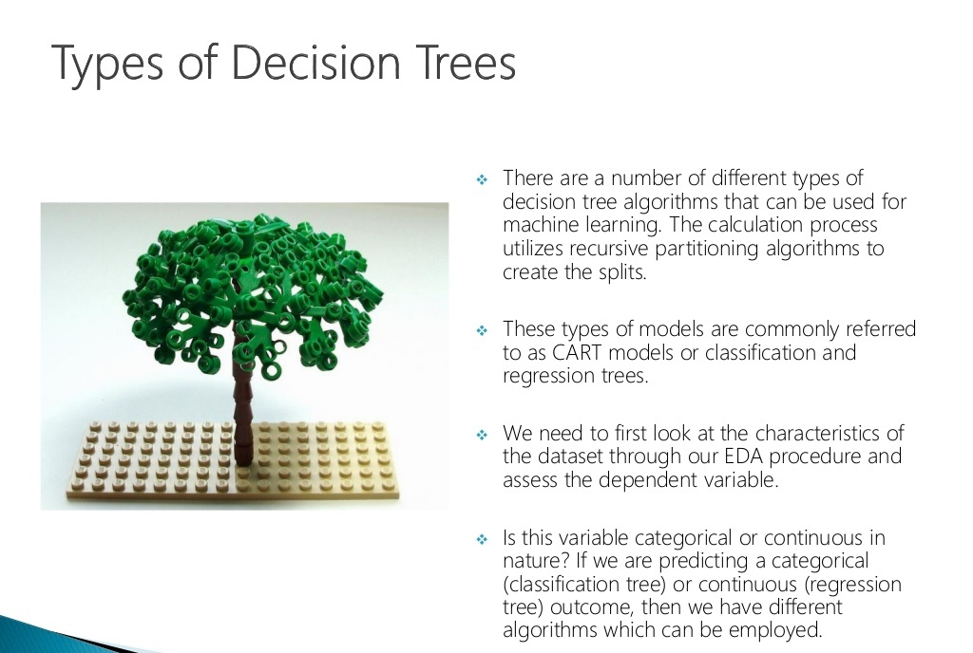

Slide 45
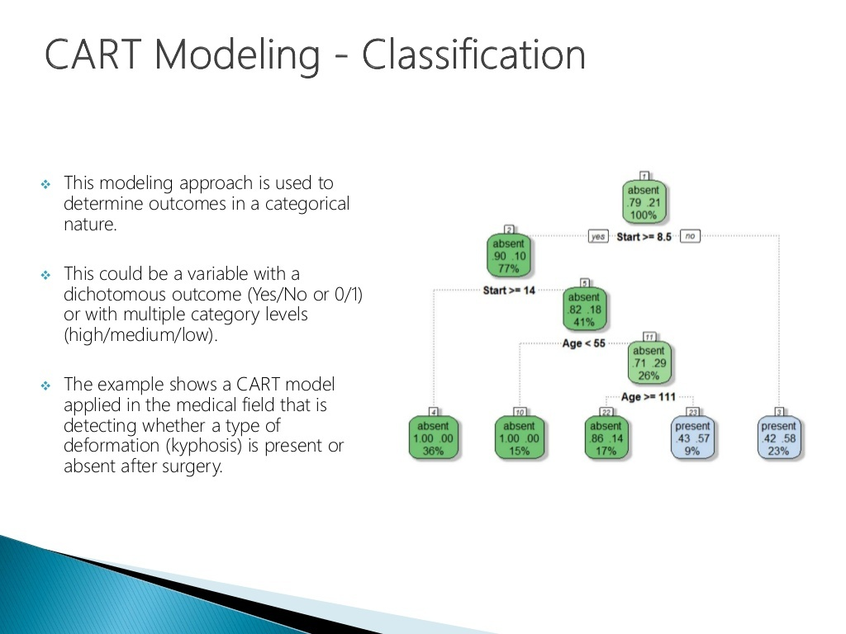

Slide 46
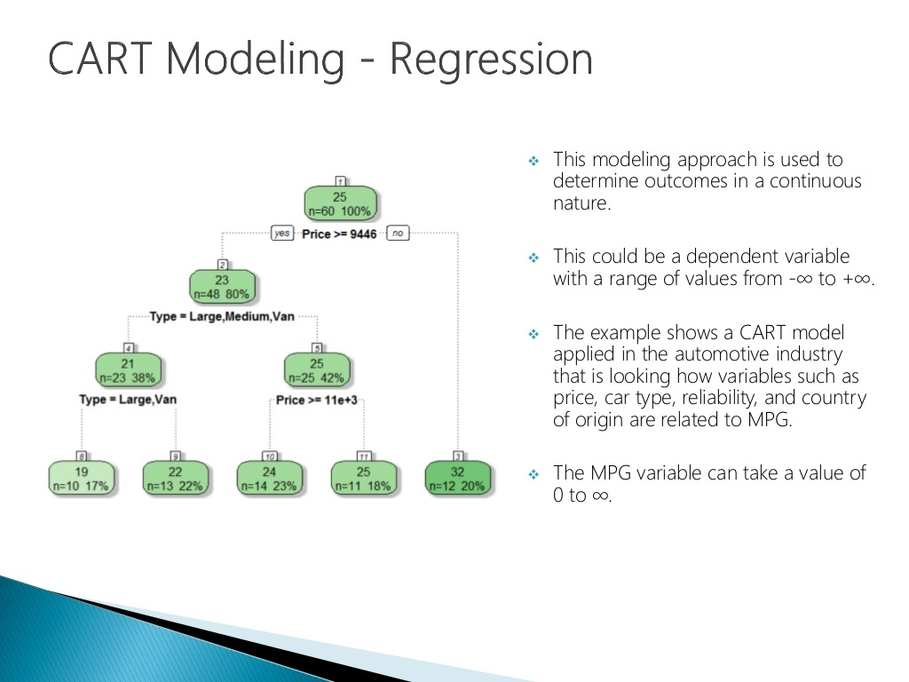

Slide 47
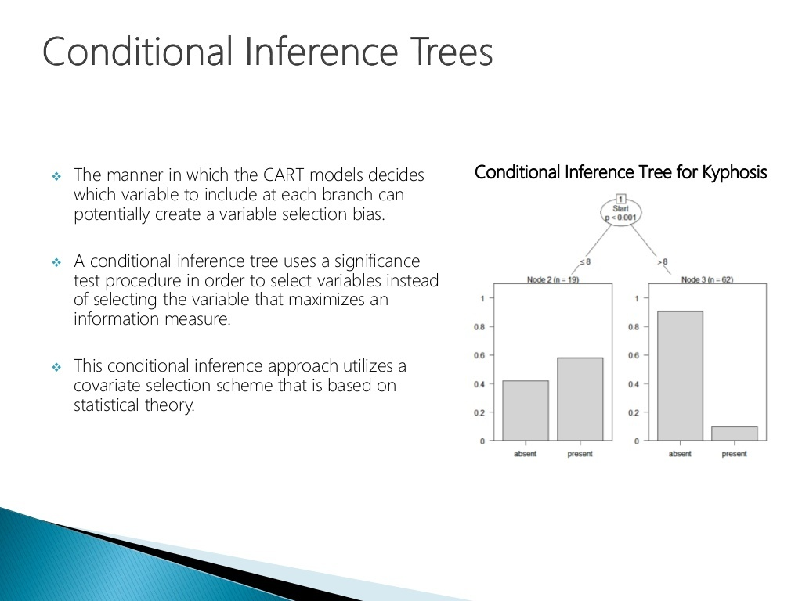

Slide 48
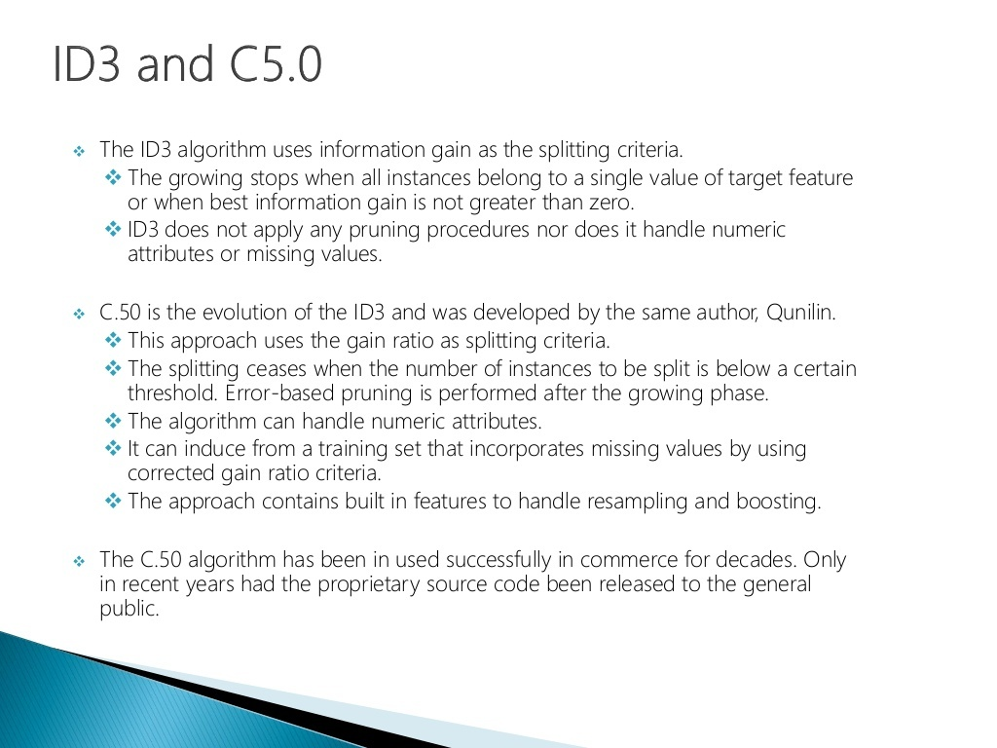

Slide 49
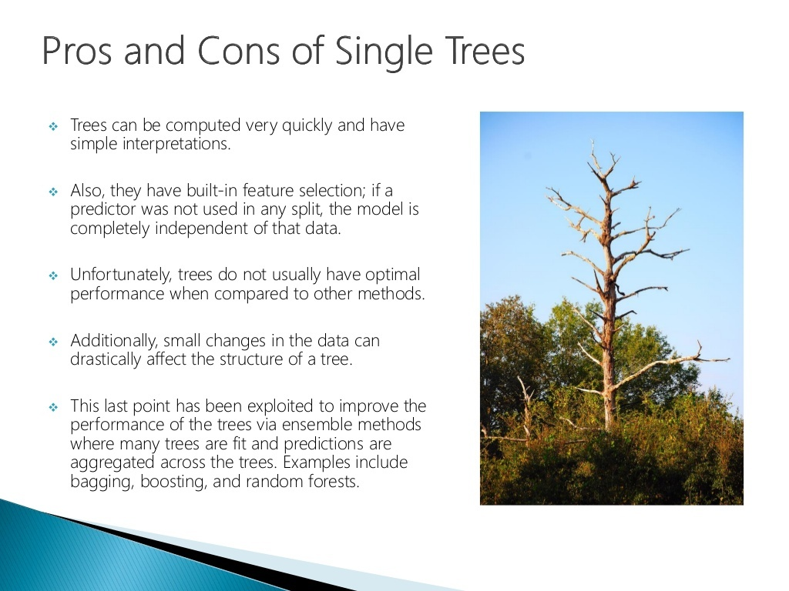

Slide 50
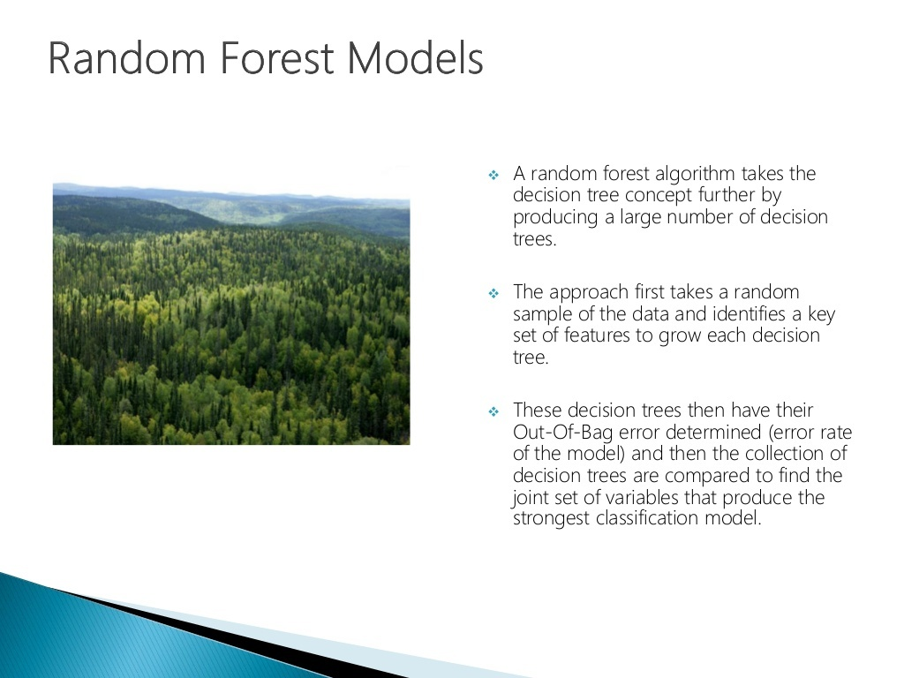

Slide 51
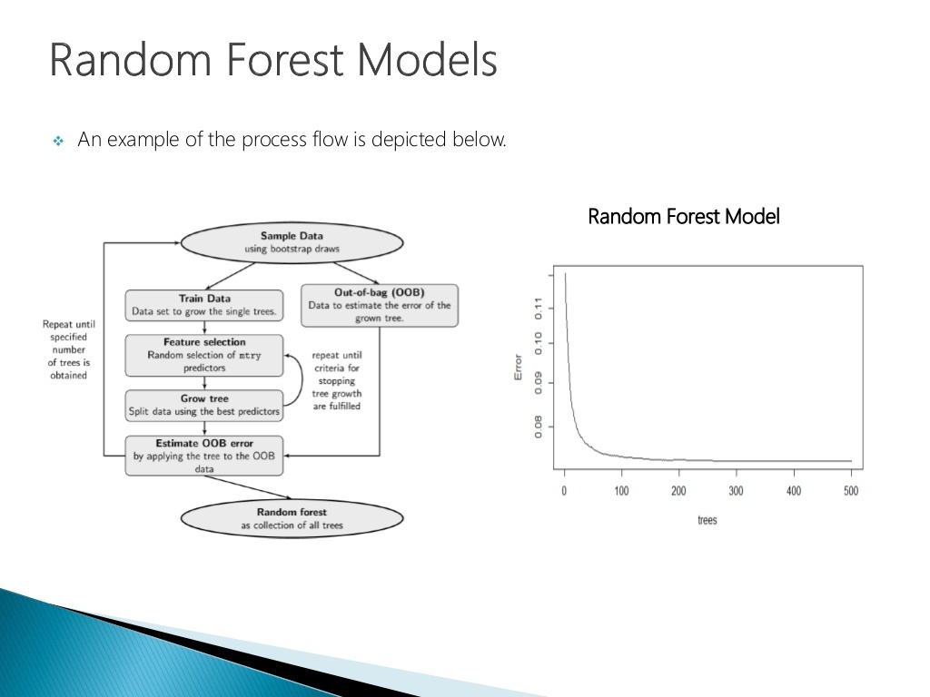

Slide 52
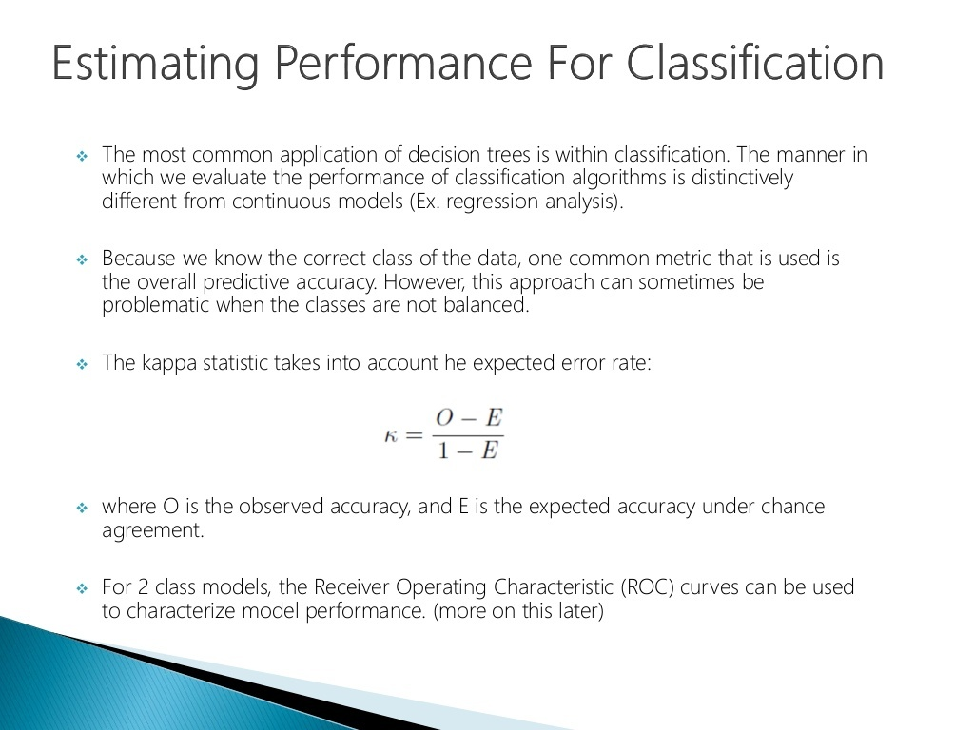

Slide 53
Random Forest Algorithm
Decision trees are easy to interpret, easy to use an easy to build.
But, in practice they are not that awesome.
Trees have one aspect that prevents them from being the ideal tool for predictive learning, namely inaccuracy.
Random Forest algorithm combines the simplicity of decision trees with flexibility resulting in a vast improvement in accuracy

Slide 54
Implementing Random Forest
Step 1: Construct a Bootstrapped dataset.
Bootstrapped dataset consists of randomly taken examples from a dataset. Here we are allowed to take a sample more than once i.e dataset can contain duplicate entries also.
Let’s use the same dataset that we used for decision tree.

Slide 55
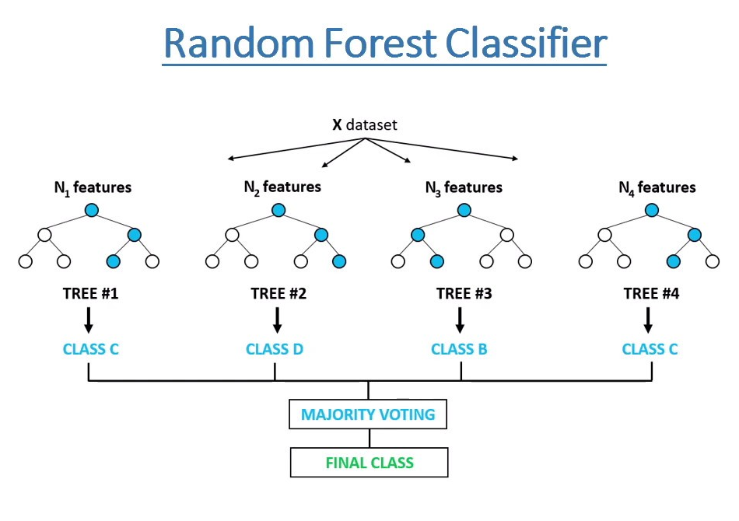

Slide 56
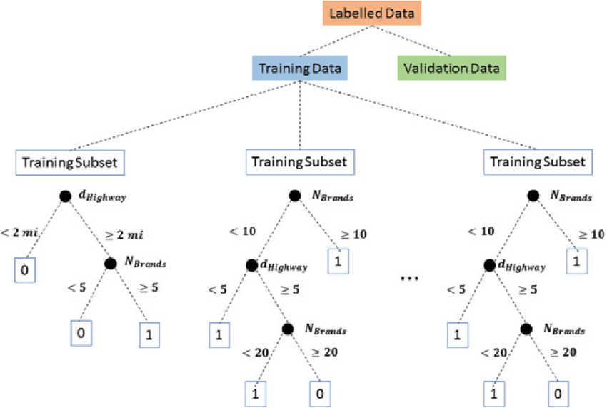

Slide 57
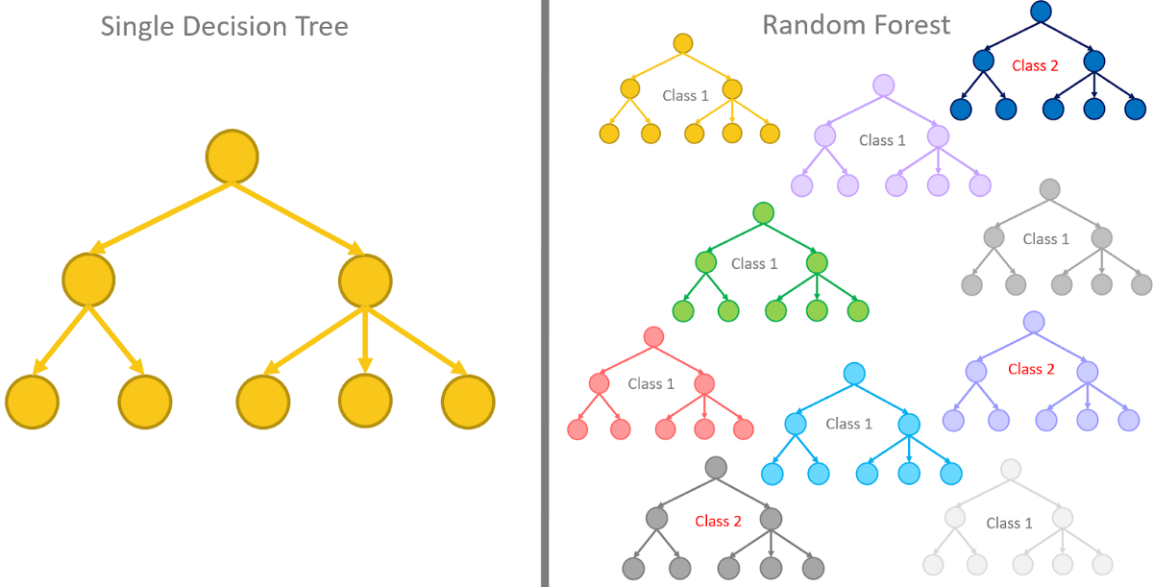

Slide 58
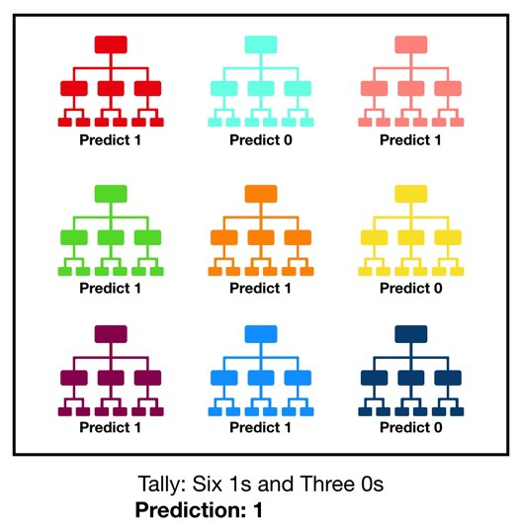

Slide 59
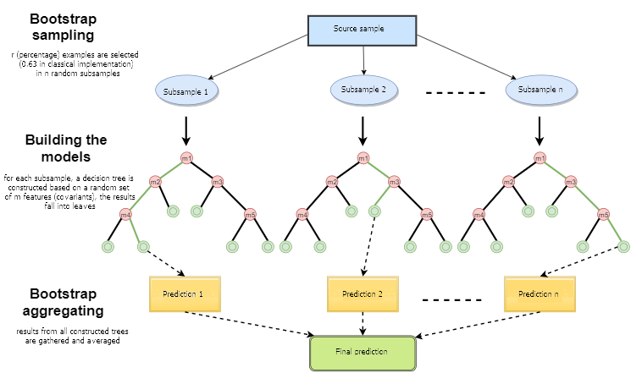

Slide 60
Constructing Dataset
Chest Pain | Good Blood Circulation | Blocked Arteries | Weight | Heart Disease
No | No | No | 125 | No
Yes | Yes | Yes | 180 | Yes
Yes | Yes | No | 210 | No
Yes | No | Yes | 167 | Yes
...etc | ...etc | ...etc | ..etc | ...etc
Chest Pain | Good Blood Circulation | Blocked Arteries | Weight | Heart Disease
Yes | Yes | Yes | 180 | Yes
No | No | No | 125 | No
Yes | No | Yes | 167 | Yes
Yes | No | Yes | 167 | Yes
...etc | ...etc | ...etc | ..etc | ...etc
Original Dataset
Bootstrapped Dataset

Slide 61
Step 2: Create a Decision Tree using the bootstrapped dataset, but only use a random subset of variables(or columns) at each step.
Therefore while selecting the attribute at the node we have to select it from a random subset of the columns.
Now, for the root node we will randomly select a subset say Good Blood Circulation and Blocked Arteries(Note: here we are using a subset of 2 variables only)
Now we perform exact same steps that we were doing in decision trees i.e checking the impurity for both the attributes and selecting one which has the lowest.

Slide 62
So we get Good Blood Arteries at the root node.
Now we will perform exact same steps for selecting the attributes at other nodes, but now we will not select good blood arteries as it is already at root node.
After performing all these step we will get a tree.
Good Blood Circulation

Slide 63
Basically we construct a tree by following steps:
Using bootstrapped dataset.
Only considering a random subset of variable at each step.
Now go to Step 1 and repeat make a new bootstrapped dataset and build a tree considering a subset of a tree at each step.
By doing this we get the following trees.

Slide 64
Note: Here we have followed the steps for 5 times so we have got 5 tress, Ideally you can perform this 100’s of times.

Slide 65
Using a bootstrapped dataset and random subset of variables at each steps results in wide variety of trees.
This variety is what makes random forest more effective than individual decision trees.
Remember we have made this trees by using a random subset of 2 variables only, now we have to take some different size for subset and follow the exact same steps.
This results in getting a different random forest.
We do this for variable size of subset of variable used at each steps. Generally we start by square of number of attributes as size than try a few setting above and below.
After doing this we choose the random forest which performs more correct.

Slide 66
Using Random Forest
For using a random forest we take a test data from new patient.
Chest Pain | Good Blood Circulation | Blocked Arteries | Weights | Heart Disease
Yes | Yes | No | 210
Now, we will pass this input to all the trees in random forest.
After this we will calculate how many trees gives Yes and how many trees gives No as output.
Then we will select the average output as the prediction for this test data.

Slide 67
Yes
Yes
No
Yes
No
As Yes has more votes, test data will get Yes as the label.
Yes | No
3 | 2

